Slide 1

Coding with Intelligence
Presented by:
John Dohoney, Jr.
SDP, US West

Slide 2

What does Copilot do for you
Prompting
How do you squeeze the most out of Co-Pilot
Labs
CoPilot Setup and CodeSpaces
Using CoPilot for Infrastructure as Code – ARM/Terraform

Slide 3

Prompts by John Dohoney
Image Creation by DALL-E
https://www.bing.com/images/create

Slide 4

co·pi·lot (ˈkōˌpīlət/) a qualified pilot who assists or relieves the pilot but is not in command
The design pattern for Microsoft/Github AI tools

Slide 5
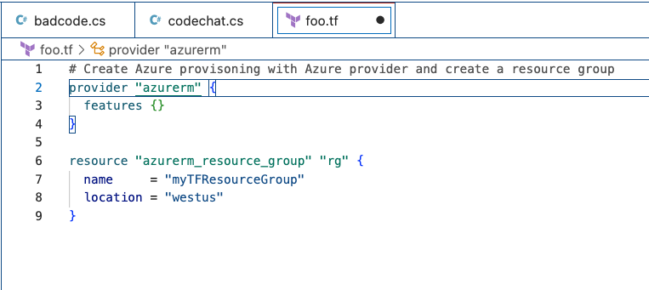



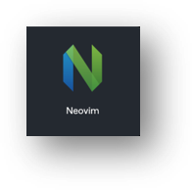
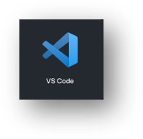

OpenAI Codex
Prompting
Be specific
Be clear about what you want done
The more information, the better the result
Operates off plain English – no special syntax
Context
Prompts and Suggestions

Slide 6
Prompting – Best Practices
Set the stage with a High-Level Goal
This is most helpful if you have a blank file or empty codebase. In other words, if GitHub Copilot has zero context of what you want to build or accomplish, setting the stage for the AI pair programmer can be really useful. It helps to prime GitHub Copilot with a big picture description of what you want it to generate—before you jump in with the details.
When prompting GitHub Copilot, think of the process as having a conversation with someone: How should I break down the problem so we can solve it together? How would I approach pair programming with this person?

Slide 7
Prompting – Best Practices
Make your ask simple and specific. Aim to receive short output from GitHub Copilot
Once you communicate your main goal to the AI pair programmer, articulate the logic and steps it needs to follow for achieving that goal. GitHub Copilot better understands your goal when you break things down.
(Imagine you’re writing a recipe. You’d break the cooking process down into discrete steps–not write a paragraph describing the dish you want to make.)
Let GitHub Copilot generate the code after each step, rather than asking it to generate a bunch of code all at once.

Slide 8
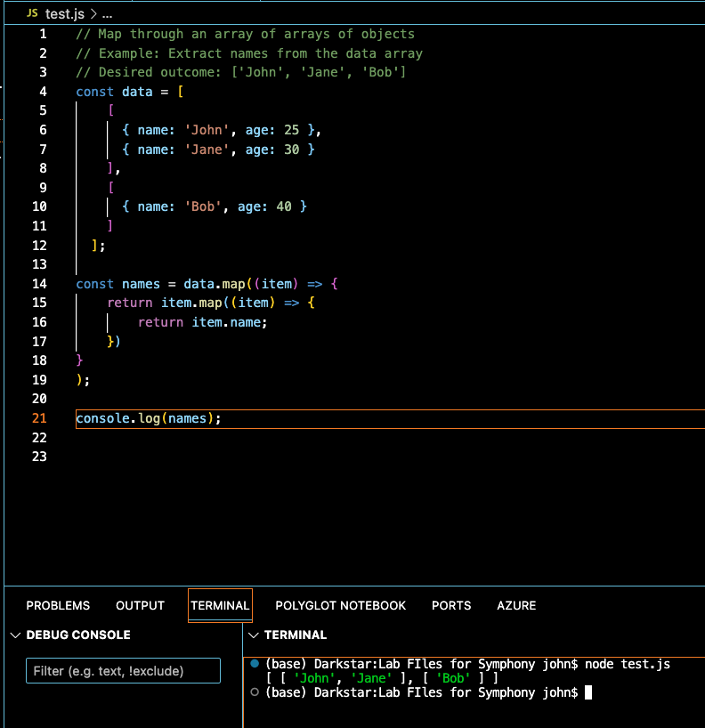
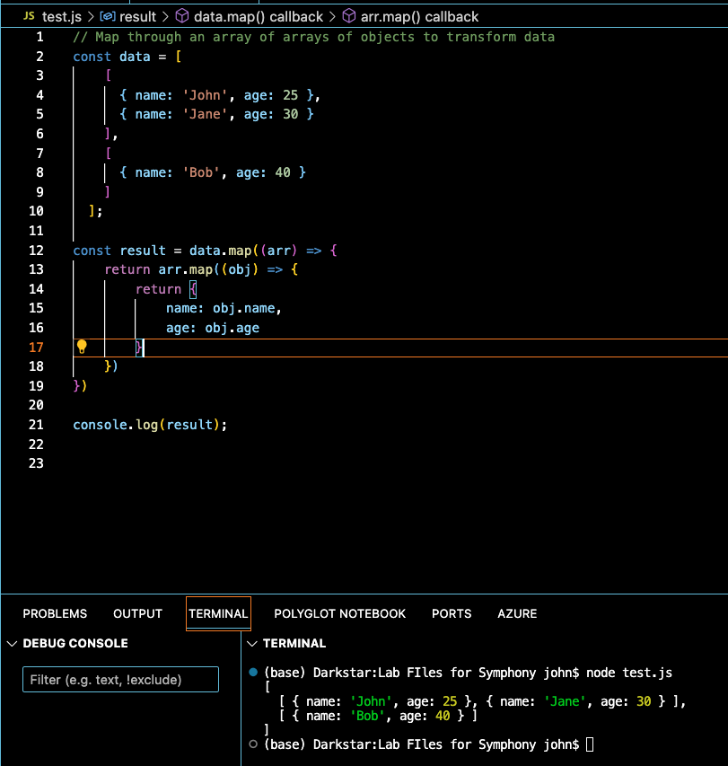
Prompting – Best Practices
Give GitHub Copilot an example or two
Learning from examples is not only useful for humans, but also for your AI pair programmer.

Slide 9
Prompting – Basics
Experiment with your prompts.
Just how conversation is more of an art than a science, so is prompt crafting. So, if you don’t receive what you want on the first try, recraft your prompt by following the best practices in the previous slides.
Keep a couple of relevant tabs open
No exact number of tabs is documented that you should keep open to help GitHub Copilot contextualize your code, but from my experience, I found that one or two is helpful.
GitHub Copilot uses a technique called neighboring tabs that allows the AI pair programmer to contextualize your code by processing all of the files open in your IDE instead of just the single file you’re working on. However, it’s not guaranteed that Github Copilot will deem all open files as necessary context for your code.
Use good coding practices.
Provide descriptive variable names and functions. Follow consistent coding styles and patterns. I’ve found that working with GitHub Copilot encourages me to follow good coding practices learned throughout my development career.

Slide 10




What does Copilot do best
Code Conversion
Pair Programming
Test Case Coverage advisor
Refactoring Assistant

Slide 11

Labs
Setting up CoPilot on CodeSpaces
Copilot and Infrastructure as Code (IAC)
Copilot and Python, APIFlask, and OpenAPI
CoPilot and Machine Learning

